Slide 1
Huh?
IBM z13.
Jonathan Gladstone, P.Eng.
for CMG Canada – Apr. 14, 2015
Big Blue’s announcement raises questions!

Slide 2
Abstract
IBM just recently announced the latest generation of their mainframe systems. This is the thirteenth generation since they switched to CMOS processors in 1994; following the well-established “z” naming they’ve used since 2000, IBM aptly calls this the z Systems z13. The z13 introduces a variety of new features, as expected, but aspects of its architecture, timing and naming raise questions for the community of mainframe users. This presentation will take a look at some of those questions and their implications for future trends in this fundamentally important computing platform.
z13 selected New Features
SMT, SIMD
Assorted I/O changes
Architecture Questions
ICA… and sometimes Y
Naming Questions
Whither BC?
Timing Questions
How low can we go?

Slide 3
z13 selected New Features
SMT/SIMD – it’s about time!
zIIP/IFL only for SMT, and watch for single-thread execution time
Use optimized libraries for SIMD
Crypto Express 5S… Express5S?
Double the capacity – yay! Now we have as much on a single card as we did with Express 3C. But what about effective capacity?
FICON 16S
Only negotiates down to 4Gbps… watch for old infrastructure!
OSA Express 5S
10Gbps cards have only one port, and won’t work with 1Gbps machinery
And some things haven’t changed…
New profiles for CoD features probably unavailable after LIC EoM.
Notes:
SMT / SIMD
Simultaneous Multi-Threading – better throughput… but single thread execution rate may suffer
Single Instruction Multiple Data – “vector processing”, one instruction sequence on many data inputs
Crypto Express 5C
CEX3C had two 4765 chips; CEX4S had only one. CEX5S has more powerful 4767 chips, with roughly twice the capacity.
Effective capacity of one pair of 4S cards in failover is 50% of one 4765 processor – 50% of remaining single chip until saturation drives elbow in response time curve. Effective capacity of a triplet of cards in failover is 140% of one processor – 70% of remaining two chips. Effective capacity of one pair of 5S cards is 50% of one 4767 processor, or roughly 100% of one 4765 processor – 50% of remaining single chip, which is roughly twice as powerful. So price for two 5S cards had better be no more than two-thirds as much as for three 4S cards… in other words, same or less per 5S as for 4S.
OOCoD
- Same as z9, z10, z196/114… no apparent change so no reason to imagine it will be different.

Slide 4
some other New Features
Stealing Jim’s thunder? Who, me?
Multiplex Pricing (CMLC)
Interesting opportunities! ‘Flattening’ demand spikes across sites; potential for cross-site workload sharing. Drops one barrier for ‘Business Resiliency’ models.
IBM Collocated Application Pricing (ICAP)
Great if you’re growing new workloads. Not so much if you’re workloads are ‘traditional’ or growth is organic.
Notes:
Pricing Presentation
- Ask your account team for the internal presentation and accompanying audio track – they should have been told they were allowed to share it.

Slide 5
Architecture Questions
Coupling Facility links
Infiniband turned up on the scene with System z10 in 2008
Coexisted with ISC3 on z10, z196, zEC12
z13 is the first generation to no longer support ISC3… … and the first to introduce Infiniband’s replacement
Now we’re moving to ICA?
And still no more fan-outs…?
This is OK for very large enterprises using multi-drawer CECs.
What about single-drawer CECs and Business Class machines?
Oh, WAIT!!!
Notes:
CF links
Infiniband introduced with System z10 (G10); some features could be back-fitted to z9.
Infiniband and ICA both use fan-outs on the book/drawer – that’s a problem for single-book customers, especially during transition!

Slide 6
Naming Questions
z13… not z13EC or zEC13, so will there be a little brother?
“Business Class” machines usually trail “Enterprise Class” machines to market by about a year
Naming has explicitly hinted at little brother in many generations: z9EC, z10EC, zEC12
IBM reps are being cagey…
No, wait…
I think Jim answered that.
Notes:
Trailing Edge
Shortest time from EC GA to BC GA is 8 mo (G9, z9EC to z9BC; G10, z10EC to z10BC); longest is 16 mo (G7, z900 to z800)
Recent generations have been about 12 mo (G11, G12)

Slide 7
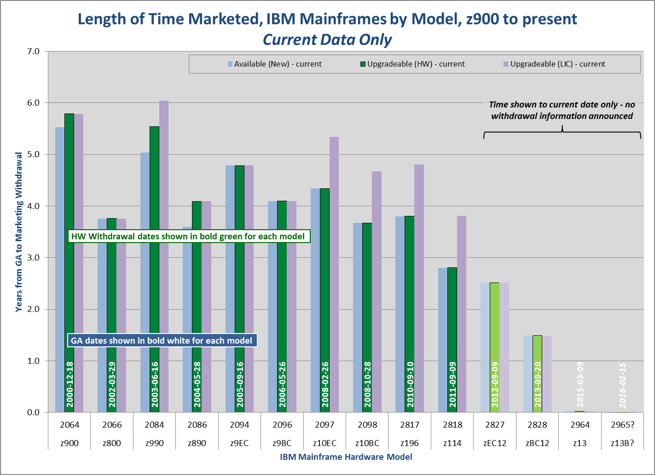
Timing Questions
IBM appears to be shortening the life cycle for “marketing availability”
But let’s see…

Slide 8
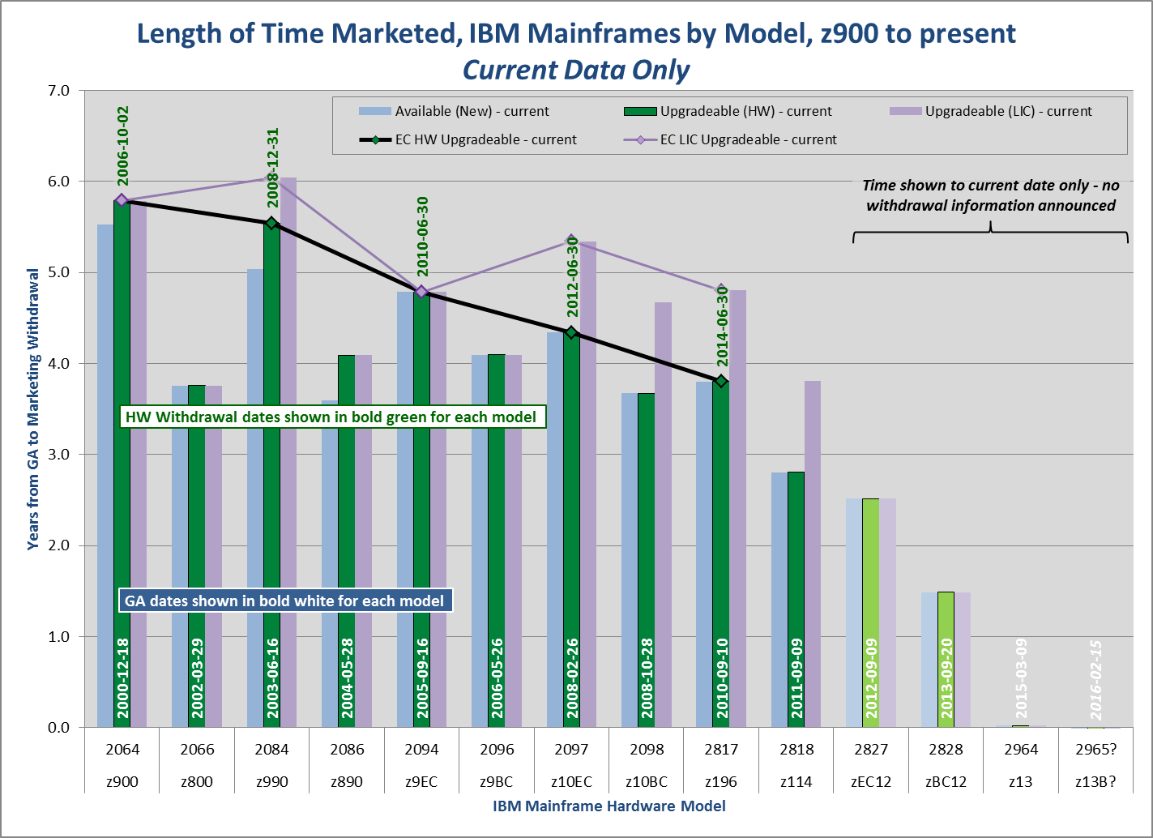
Timing Questions
IBM definitely is trending to shorter life cycle for “marketing availability”
But do we care?

Slide 9
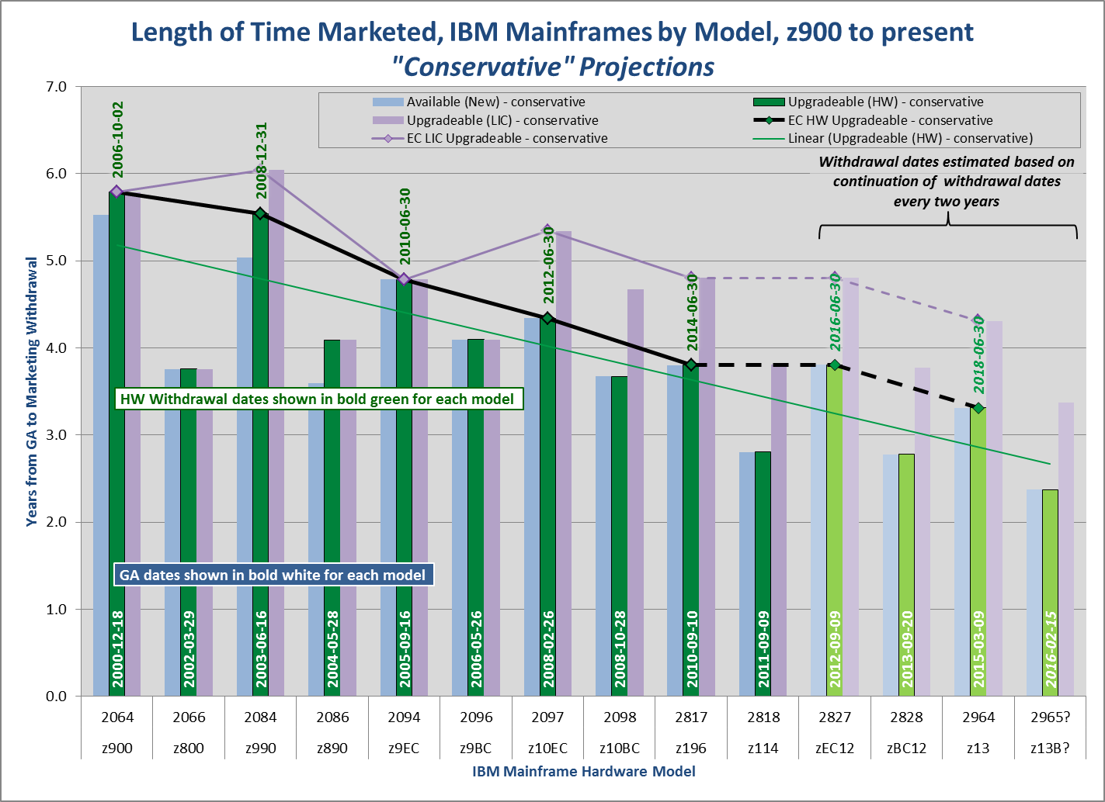
Timing Questions
IBM won’t predict future withdrawal dates (of course).
But we can! It looks really bad…

Slide 10
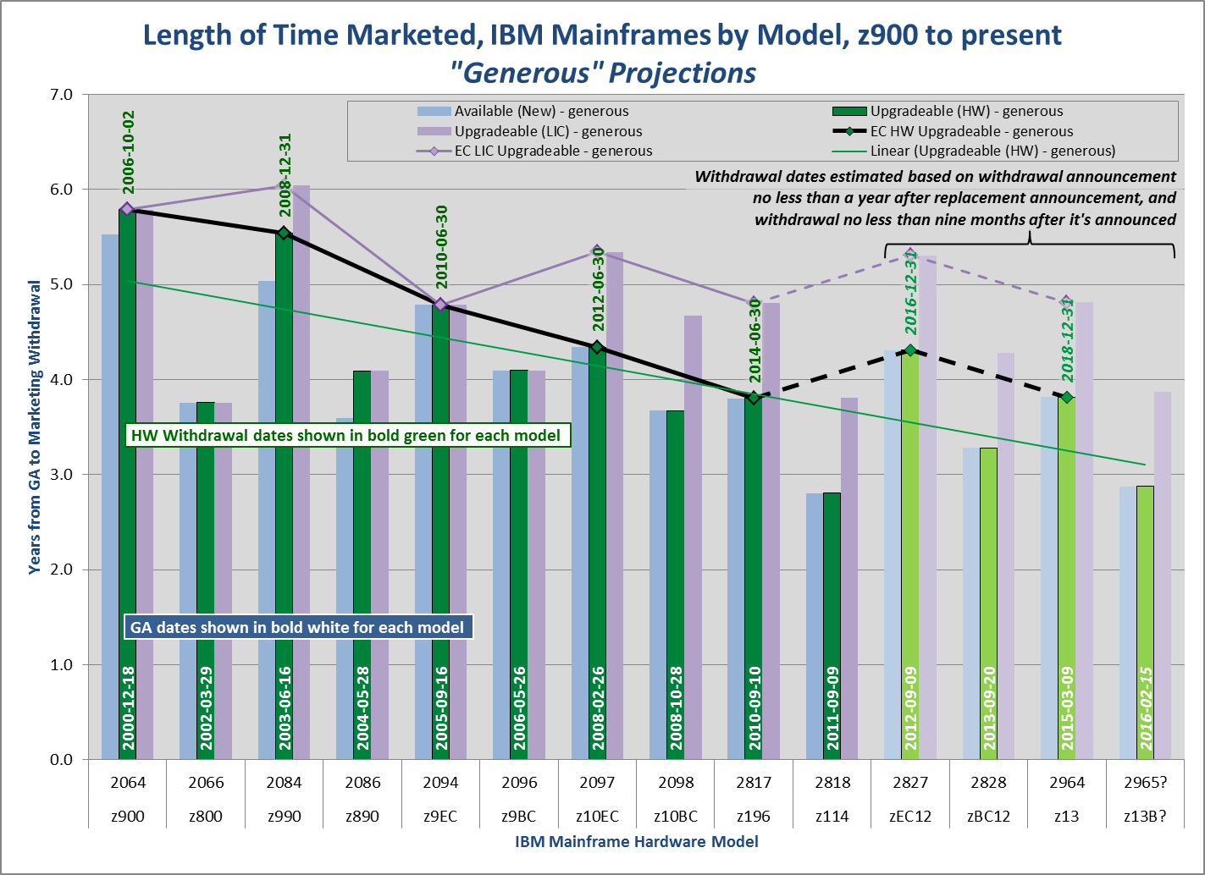
Timing Questions
IBM won’t predict future withdrawal dates (of course).
… or we can be more generous.
But it’s still pretty bad!

Slide 11
Questions?

Slide 12
Selected References
My material comes from broad reading in the public realm as well as from day-to-day experience; this is just a small sample of recent relevant articles rather than an exhaustive list of references. In reverse date order…
“Parallel Sysplex”
IBM website as of Apr. 13, 2015
http://www-03.ibm.com/systems/z/advantages/pso/ifb.html
“IBM System z10”
Wikipedia as of Apr. 13, 2015
http://en.wikipedia.org/wiki/IBM_System_z10
“Country Multiplex Pricing”
IBM presentation & audio file, Mar. 3, 2015
“ IBM unveils z13 mainframe to tackle burgeoning mobile transaction data”
V3.co.uk tech news site
http://www.v3.co.uk/v3-uk/news/2390071/ibm-unveils-z13-mainframe-to-tackle-burgeoning-mobile-transaction-data
This article was my first authority for Crypto Express 5S processing chips being twice as powerful as the 4735 chip in the 4S and 3C cards.
“IBM z13 and Crypto”
Greg Boyd, Mainframe Crypto LLC, Jan. 2015
http://www.newera.com/INFO/2015Crypto3.pdf
“IBM z13 Technical Guide”
IBM SG24-8251-00, draft as of Jan. 15, 2015
“IBM z13 FAQ”
IBM ZSQ3076-USEN-pp, Jan. 2015

Slide 13
Appendix: IBM Mainframe Dates (1 of 2)
Showing projected “generous” marketing withdrawal dates for zEC12, zBC12 and z13 based on the assumption (driven by historical data) that marketing withdrawal announcements will be made no earlier than a year after general availability of the replacement generation, and will take effect no less than nine months after the withdrawal announcement. Service withdrawals are projected to take effect on Dec. 31st after the twelfth anniversary of GA.

Slide 14
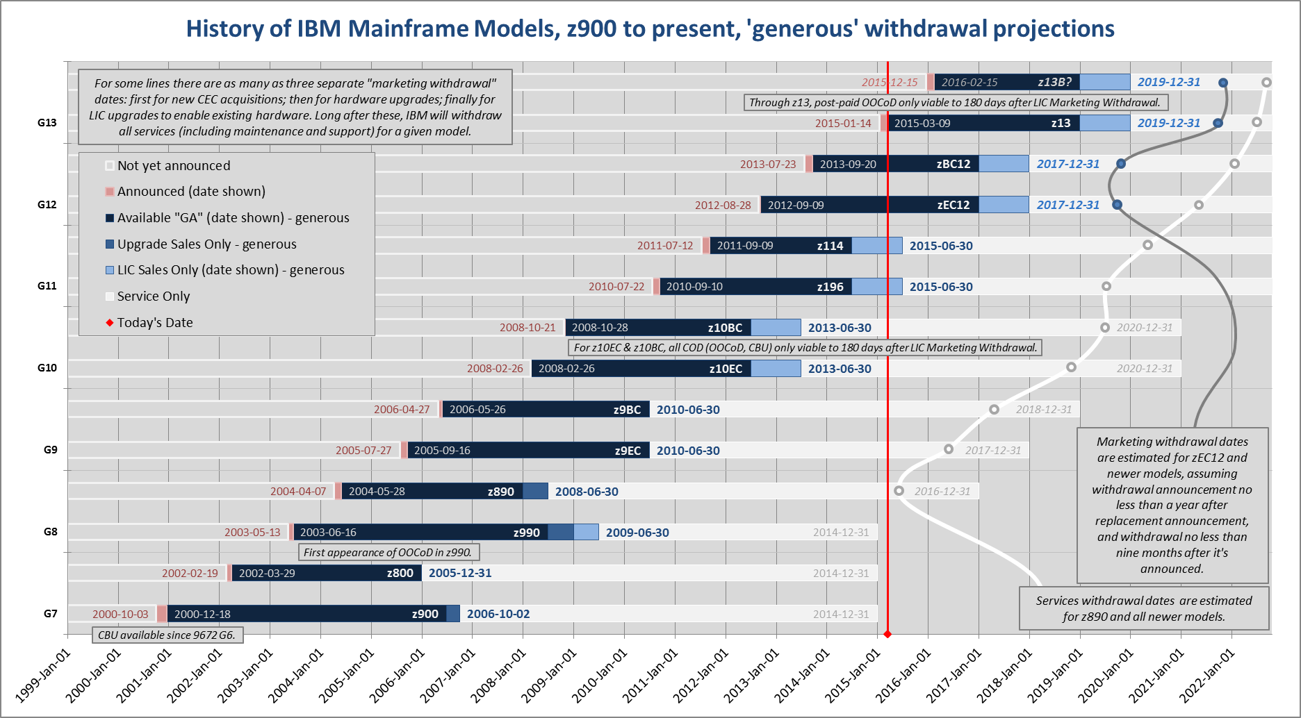
Appendix: IBM Mainframe Dates (2 of 2)
And now, in graphical form…

Slide 15
About the Author
Jonathan Gladstone is a senior information systems professional, thought leader, educator, planner and team leader with over twenty-five years of experience in capacity management, project initiation, process development, disaster recovery, change management and implementation and problem management for large corporate I/T infrastructures on a variety of computing platforms. He specializes in I/T capacity planning & management; statistical analysis; ITIL process development and implementation; and team leadership for these and other IT planning roles including change management.
He has been at the BMO Financial Group for over 15 years, and working in capacity planning for well over a decade. He is BMO’s representative on the Advisory Committee for the School of Computer Studies at Georgian College in Barrie, ON, where he also teaches part-time. Jonathan holds a B.A.Sc. degree in Electrical Engineering from the University of Toronto and P.Eng. certification from Professional Engineers Ontario and is certified in ITIL v2 and v3 fundamentals.
Jonathan has made many IT presentations over the years, including at CMG Canada, CMG Mid-west and (informally) at CMG International. You can find him online at LinkedIn, on Twitter @jbglad59 or at his blog, http://alwaysgrumpy.wordpress.com

