Slide 1
Capacity Planning and Management in the Real World
Success and Failures that we see
Alex Bewley – CTO, uptime software inc.

Slide 2
Why am I here?
Been in the systems management business eighteen years
uptime has over 150,000 systems (multiple-platforms) monitored across its customer base
We detected a trend about ten years ago, customers used our tool for:
Performance and availability monitoring
Capacity planning
Capacity planning???
Joined CMG in 2004

Slide 3
- Is It Time for Capacity Planners to Hang Up Their Cleats?. G. Jay Lipovich. Int. CMG Conference, page 237-248. Computer Measurement Group, (2005) - Gartner’s Cameron Haight: perceptions of capacity planners: mysterious and using arcane tools, honest, but focused on minutiae, unapproachable and living in an ivory tower, old fashioned and living in the past, and my personal favorite, “nerdy but generally harmless.”
Capacity Planning: How are we doing?

Slide 4
Is Capacity Planning Dead?
Jevons Paradox: The more technology driven efficiency we have, the greater the amount of consumption.
Virtualization sprawl and cloud sprawl are inevitable.
Virtualization and cloud doesn’t eliminate the need for capacity planning, it makes it more important.

Slide 5
Historical Use of Capacity Planning
We found was more about reclamation of underutilized resources
When to consolidate workloads (hardware refresh)
Use of analytics/modeling? Nope.
The line is going up at this rate

Slide 6
Capacity Planning Now
Now – more concrete mapping of cost to line-of-business
Assistance with cost optimization, especially with Cloud (AWS)
Instance sizing
Reserved Instance optimized fit
Workload analysis (batch? Spot instances) – Required understanding of application architecture

Slide 7
Largest Issues
Data extraction – sheer volume + mapping
Agent vs. no agent, migration to API data extraction
Consistent performance data – no missing data
Normalization across platforms (architecture)
Understanding on virtualization (VMware, Hyper-V, Solaris, AIX LPARS)
Presentation of data at scale
Specialized metrics (i.e. TCP retransmit rate)

Slide 8
Customer Case: Clearing Processor
VMware’s 3rd largest customer
12,000 systems, 750 ESX
Application workloads + VDI
Very large AIX systems
Three capacity planners for org (compute, storage, network)
Produce reports on ad-hoc basis as applications are reviewed or problems occur (week over week analysis)
Two years of performance data retained (no aggregation)

Slide 9
Customer Case: Bank trading floor
2,500 systems (Solaris, VMware)
75 line-of-business users
Self-service + monthly reports
Month over month analysis by LOB
Cost tracking + usage is pushed onto LOBs
Ad-hoc root-cause analysis
Capacity planning team will investigate on-demand
Migration from Solaris to VMware occurring

Slide 10
Customer Challenges
Building apps that scale
Developers are unaware of impact on infrastructure
Hard to pre-production test
What about analytics and modeling?
Not seeing it (doesn’t mean it isn’t happening)
Is the capacity planning group responsible for the infrastructure?
Centralized or push-down?
Make LOBs responsible for their applications and workloads – they have to correlate with cost and utilization
Emergence of APM tooling
How to integrate system performance/capacity with APM

Slide 11
Key Take-aways
Resolve yourself to never mention “queuing theory” again. Change the conversation to be business oriented.
Understand the links between business metrics and IT –develop links to your work. Lots of data, what’s relevant?
Improve communications about your efforts…and results.
Re-assess current processes to remove waste and increase agility.
Begin mentoring of others that need capacity planning capabilities.

Slide 12
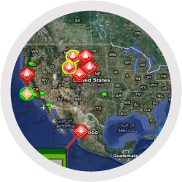
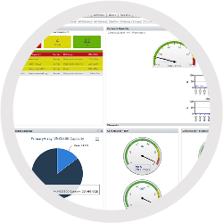
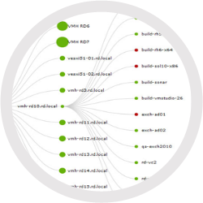
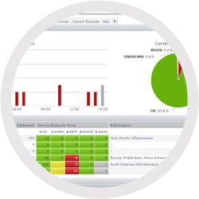
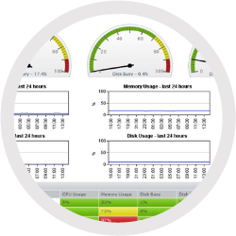
Map Dashboard
Capacity Dashboard
Topology Dashboard
Thank you.
alex.bewley@uptimesoftware.com
@AlexBewley
Global Scan
Resource Scan

