Slide 1
"It’s not always what you say…"
Ron Kaminski

Slide 2
Improving communications
All capacity planners face challenges in getting our firms to
understand and
act on what we discover
and our communications styles have to adapt to different corporate cultures to be successful
Join Ron as he shares what tricks and techniques he has learned in 28+ years that will
help you get your discoveries noticed and
techniques to greatly shorten the time between “issues discovered” and “fixes deployed”

Slide 3
Improving communications
The session will be loaded with real examples from large scale distributed environments
Ron will cover not only the content of your messages but also
other techniques that change your message from “just another nag in the pile” to “We need to act on this now!”.
Ron will end with some consulting where audience members share “less than successful” communications examples and we use what we learned to devise better ways for the future.

Slide 4
Introduction
I’ve been very fortunate in my Capacity Planning (hereafter CP) career to have some great VPs, Directors and managers that have really helped me see ways to be better and more effective
In our highly technical capacity planning world, it is easy to get lost in
the formulaic and to notice technical faults as your analysis skills progress, and
sadly some great folks become less effective to their organizations when making the faults known becomes their goal

Slide 5
Introduction
Over time and with some great guidance,
I have redefined my goals,
not just to notice all issues,
but to rate myself instead on just how many that I can get folks to fix,
which as it turns out is actually a lot more rewarding for me and my firm’s shareholders
Read on, and hopefully learn something a lot faster than I did!

Slide 6
Communication strategies: Use more graphics
Think about your mission
to get a lot of different types of folks to fix stuff
As my fishing pals say, “If you want to get them in the boat, you first have to get their attention.”
In my experience, nothing works better than graphics. Here is an example:

Slide 7
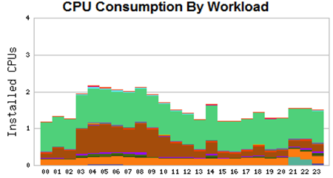
Communication strategies: Use more graphics
Here we see a
normal workday
for this machine:
This is a UK business hours application for a product transportation and file inspection, java that seems rather a consistent high consumer all day, and some virus scanning that gets a bit busier during heavier times and during backups

Slide 8
Communication strategies: Use more graphics
After seeing that graph, coupled with a “color coded paragraph”
we all have a pretty good idea of what is happening on the server
If you use colors consistently,
your users will love the convenience as they scan the many machines that make up most modern applications
They may even ask you to change their workload’s color to match a product’s graphical signature, and you should make every effort to do so.

Slide 9
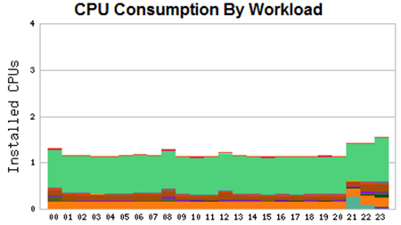
Communication strategies: Use more graphics
At this point we have enough “common ground” with your users to ask the question:
“What is that java CPU consumption doing, 24 hours a day?”
We might also ask:
what is that java CPU consumption doing all Sunday when nobody is in the office running product transportation?

Slide 10
Communication strategies: Use more graphics
I sent a color coded question like that to this application’s owner
who then took the time to look into what that java was doing
It turns out that the java had to look over 10 GB of files to see if any new work had arrived
What made it worse was that most of the files were old and no longer required!
How did it run after the cleanup?

Slide 11
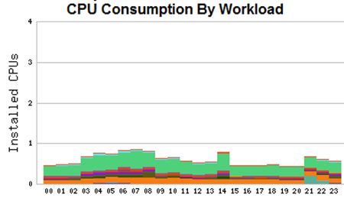
Communication strategies: Use more graphics
Everybody wins when your communication leads to improvements
Now we can see that the users hardly have to do file inspection at all
they get right to the product transportation and get much faster response times as well
Virus scanning and backups also shrank!

Slide 12
Using more graphics: Points to remember
Graphics are one of your most powerful allies in escaping flat pages of text to get the reader interested
I actually went back and rewrote the beginning of this paper to get a graph on the front page
Here are my personal graphics rules:
Always get a graph on the front page, and use colors in the text for the different workloads to help folks understand it

Slide 13
Using more graphics: Points to remember
Use the same colors in your text to anchor the user’s understanding
Remember to bold colored text, most people need more dots to properly discern colors
and some thin fonts barely show colors at all. Bolding colored text really helps folks see the colors easier

Slide 14
Using more graphics: Points to remember
Be sensitive to the fact that some folks are color blind, (men more than woman,) and change their workloads to something that they can see when you can
The types and issues of color blindness are wonderfully detailed in the color blindness wikipedia entry
where you might even discover something about your sight that you never knew

Slide 15
Using more graphics: Points to remember
It wouldn’t be a Kaminski CMG paper without a recommendation to read and embrace the work of Edward Tufte, he will radically improve your use of business graphics

Slide 16
Communication strategies: Be a friend that they can count on, not a nerdy nag with a fault microscope
A capacity planner by nature acquires and develops tools that “surface issues”
What happens next is up to the communications skills and techniques that they develop over time and their desire to be more effective.
Let’s assume that you got into data processing for some of the same reasons that a lot of us did, (myself included) namely that
machines made sense to you and rewarded your efforts to communicate with them, unlike, for example, blond cheerleaders

Slide 17
Communication strategies: Be a friend that they can count on, not a nerdy nag with a fault microscope
The deeper that many of us get into learning about IT
the less relatable to others, like project leaders or business people, we typically become
When we take the last step to being capacity planners
we are often so far from the days of normal discourse that many people frankly don’t understand us or our intentions

Slide 18
Communication strategies: Be a friend that they can count on, not a nerdy nag with a fault microscope
I specialize in automated discovery of what I call “process pathologies”, otherwise known as “code problems”
I deploy my tools at a site and hundreds of issues are automatically found

Slide 19
Communication strategies: Be a friend that they can count on, not a nerdy nag with a fault microscope
For many years I have worked hard at improving my automation
While finding more code problems makes me quite happy
I’ve found over time that it can have the opposite effect on project leaders in charge of what we will charitably call “challenged code”
Much to my surprise, they view automation that finds hundreds of issues in the code that they are responsible for in less than positive ways

Slide 20
Communication strategies: Be a friend that they can count on, not a nerdy nag with a fault microscope
My goal in surfacing issues is to help folks learn what to avoid
like an orange road cone in a pothole
Given time and repeating examples, most folks stop writing loops, ramps and other problems
Over time, you can largely drive these issues out of an organization and greatly reduce IT expenditures
However, if folks start out with the goal of not listening to you or disagreeing with your ideas
it doesn’t work so well

Slide 21
Why would they disagree?
Well examine their incentives
Most project or team leaders are rewarded for
installing more new code, or
adding new features that the business needs, and the sooner the better
When problems occur, that can slow them down, and make them miss deadlines
When someone starts finding a lot of code malfunctions, they will predictably experience the five stages of grief, and react accordingly:

Slide 22
The 5 stages of grief
Denial
Anger
Bargaining
Depression and finally,
Acceptance
Think back over recent times when you have pointed out “code issues” to folks, and how often you’ve seen these five reactions, in sequence

Slide 23
Why would they disagree?
While that is normal human behavior, the algorithm side of me started looking for ways to get to “Acceptance” faster, and
using the scientific method, I started running some experiments to see what worked quickest

Slide 24
The great communicators
I’d love to say that these next ideas flowed fully formed just from my head
but to be honest, I got the first idea from some gifted communicators that I saw in action
People understood and empathized with their calm, reassuring, friendly demeanor
They can often calm and make troubled or “special students” more productive in class

Slide 25
The great communicators
How do they do it?
They act interested in the others in all cases, and by listening to them it puts them at ease, and praises their efforts before offering opinions about changes
Since their “challenged students” already view them as a friend
the students often completely skip the first four stages and accept the instructor’s ideas quickly
That translates into much faster progress from “issue detected” to “issue resolved”.

Slide 26
The great communicators
The most effective communicators also made sure to point out and praise their successes to their bosses
They know that makes them even nicer and more cooperative faster the next time that they work with them
After watching them several times, the great gifted communicators seemed to be nice to folks at least three times per issue surfaced, so I now had a goal

Slide 27
The great communicators
There are several large groups in charge of major applications at our firm, and I had some strong and repeated evidence that
they were pretty tired of hearing about new software issues
I decided that the problem was mine, not theirs
and started a series of experiments with the end goal of getting to “Acceptance” faster
I started my experiments with “listening”

Slide 28
CP and Application Cross Training
As many of these larger software packages can be quite complex
I set up repeating, periodic “cross training” meetings where
they can teach us more about their applications
and we CP and operations folks can learn more about what their application needs
We also shared hints on how they could get more from our automated reports

Slide 29
CP and Application Cross Training
Not only did this help the firm by driving off some misconceptions
the jokes and camaraderie helped us build a team mentality
and when a team member brings up an issue, folks are far more likely to view it not as a threat, but instead as how it was intended, an issue that we can fix that makes us better together
When folks are looking forward to the meetings, and using your graphics to describe their application issues, you know that you are in the right track

Slide 30
Improving “Issue surfacing”
I then looked at our typical issue notification memos, and thought “How would the good communicators say this with three nice things?”
Traditionally we would send
a concise description of the issue discovered,
links where they could see more detail,
offers of expertise and
a request for them to fix it ASAP

Slide 31
Improving “Issue surfacing”
While that may be a wonderfully concise way to convey information,
I wasn’t getting quick “Acceptance” feedback too often
We decided that being “the expert” didn’t work as well as being a friend

Slide 32
Improving “Issue surfacing”
So, we decided to try some friendlier methods, some subtle, some rather overt
Instead of starting out with “You have this exact problem” or accusing rhetoric,
we instead started out with a friendly greeting, followed by a ‘Could you help us understand what this consumption could be?” phrases that let them be the experts in the idea flow
Lastly we offered them all of our data and to help with vendors if that would be useful.

Slide 33
Improving “Issue surfacing”
The difference in outcomes was striking
After they started viewing us as pals
people were forthright in pointing out issues themselves
and asking for data to help resolve them
In the case of the first colorful example in this paper,
a friendly graphical memo that didn’t demand an answer to “Why did you write a java loop?”
but instead asked “What could be the cause of this resource consumption pattern?”
The subtle change quickly led to an engaged application owner who then spent the time to properly diagnose the underlying issue and fix it right away!

Slide 34
Tell their boss when they do it right!
These days, when someone works fast and fixes something, following the great communicator’s examples, I make sure to send a “Thank you-gram” to them
and to include their boss if you can
This is usually appreciated, and especially when you praise “outsourced” or “contract” labor
including both their external firm boss and
who their group reports to in your firm, because their managerial efforts made it possible

Slide 35
Tell their boss when they do it right!
Remember, with software of even moderate complexity
there will always be a “next time”, so invest in the careers of helpful folks
It will really pay off for everybody.

Slide 36
Emotions never help
Many corporate “political maneuvers” experts say that the first to show emotion typically is seen as desperate and loses
My pal Shane says “Let the data drive the discussion. Don’t let emotions get in the way”
This is often especially true for vendors who don’t listen or have preconceived notions about hardware specifications
Repeated experiments have proved his point

Slide 37
Emotions never help
Here is an example
Usually a single process causes a CPU loop, but sometimes in rare cases an application can be “Single threaded”
so that no matter how much hardware is available, it’s program logic won’t let it ever use more than one CPU, or “thread” at a time
Getting peeved and complaining about bad code just wastes everyone’s time

Slide 38
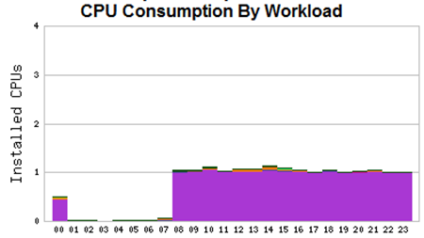
Emotions never help
Start with a graph like this:
Ask the application owner to ask their vendor to explain why 168 processes would split up exactly one CPU evenly for 16+ hours and
how that “Single threaded logic” would not greatly lengthen user perceived response times?
That puts you on “their application’s side”
helping defend their users from the beginning
and often skipping all of the “That isn’t a bug, it is a feature” nonsense

Slide 39
Share graphics and data with the vendors
When we discover a problem, we have found that
the sooner we share the graphics and underlying data with the vendor
the sooner they admit to and start working on the actual problems
We usually send both graphics and data in the opening memo to the application folks, enough to prove our point

Slide 40
Share graphics and data with the vendors
Since you looked into all of this before you decided to ask them to fix it, there is little point in hiding it
Sometimes sharing makes you the vendor’s favorite customer
getting your firm new releases and beta versions sooner, because they believe that you will be a partner, not just a complainer

Slide 41
Pick up a phone, do some 1 on 1
When you have a great calming “We can fix it!” phone personality,
or if you can train yourself to get one,
sometimes a phone call (often with a graph link in IM too) can be a lot faster way to get some (not all) folks moving faster
Sometimes certain members of the CP team are better with some folks than others, so over time you will develop lists of phone, IM and mail preferences

Slide 42
Pick up a phone, do some 1 on 1
Some folks get really steamed if their application is shown to be busted on an e-mail to a lot of people
These people often react quite well to a quick call or IM to notify “just them” of an issue, and they take it from there
Remember, what matters are resolutions for the end users, not some precisely repeated process that airs everyone’s dirty laundry

Slide 43
The ‘big late project’
A great example of a good place to keep things more private is when you are asked to help a ‘big late project”
Typically, the techies will be exhausted, and
the project manager (hereafter PM) will want you to help
but will also already be somewhat guarded and be keenly aware that there are ‘performance issues’ with the project

Slide 44
The ‘big late project’
While your gut instinct may be to surface problems,
the PM may react quite negatively to making the list public.
If our goal is to use our information in a way that does the most good for the organization,
often the best way to deal with these political situations is to do great research, find issues and answers,
and then be sure to tell only the PM and technical leads of the project

Slide 45
The ‘big late project’
Indeed, I was asked to investigate a large (and late) product roll out effort recently and
after outlining the major issues that I had found so far in the first meeting,
the PM did not ask first for how to fix them, but rather
‘Who was I going to tell?”
When I said that I intended to do accurate research,
surface all issues, and
only tell the technical lead and the PM,
and they can chose to tell who they wanted, things calmed down markedly.

Slide 46
The ‘big late project’
They reacted much better to a “keep it in the family” policy, and
if our goals are to focus folks on making changes that help the users quickest,
all time lost to worry and politics is wasted
Our job is to find technical solutions, and let the PMs concern themselves about the “Political Messages”

Slide 47
The powers of position and the powers of persuasion
As your early career progresses and your CP skills kept saving or making firms tens of millions of dollars,
they keep trying to find ways to pay you more, to keep you around
At some point someone will promote you to management, and then you can build these CP skills in others and multiply the effectiveness of your efforts
When you get high enough in the management hierarchy, say director, you can often just compel folks to fix stuff not just because you believe it to be broken, but because they work for you

Slide 48
The powers of position and the powers of persuasion
After several years of that, trust me, you can get “set in your ways”,
and then when business conditions change and you find yourself in a non-managerial role in a new firm again,
it can be very surprising to see that folks aren’t just running off and making changes when you merely mention them
At that point, (or perhaps before, after you have read this paper) you realize that the real game is to influence the organization to change for the better,
and then the tools and techniques that you use to persuade folks become much more important to your success
So, compel folks quickly and politely when you can, but use the other hints too!

Slide 49
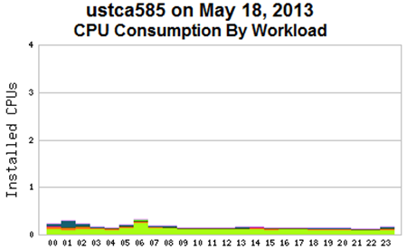
Use a more consistent graphical language: Full is bad
Most folks seek consistency in reporting, and even make some up when it isn’t there
Let’s use some examples to prove the point
If you showed the following CPU usage graph to the average project leader
whose stable and minimally growing application has been stably running for months, they likely would not register a CPU capacity concern

Slide 50
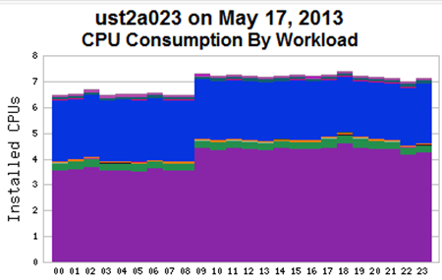
Use a more consistent graphical language: Full is bad
But a project leader whose phone is ringing with more and more performance concerns as the week goes on is likely to react differently to this CPU graphic
It is common for folks to react in alarm when a resource looks “full”,
(and even more so if it is still growing)
especially when anecdotal evidence suggests performance concerns

Slide 51
Use a more consistent graphical language: Ramps that will fill soon are bad
Most folks can do reasonable visual extrapolation. Few will have trouble seeing how soon this might end:
I can hear the queuing theory tool users at this point yelling “Ron! Full does not matter; response time growing is all that matters!” For those folks in the crowd, here is another ramp, note the growing CPU Wait:

Slide 52
Use a more consistent graphical language: Ramps that will fill soon are bad
For those folks in the crowd, here is another ramp, note the growing CPU Wait:
I included the graph above with the original workload characterized ramp to show them not only the consumption, but also the effect on user perceived response times

Slide 53
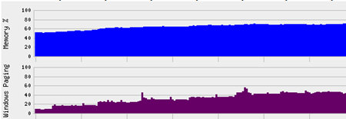
Use a more consistent graphical language: Ramps that will fill soon are bad
Similarly, growing total memory and paging is likely to get folk’s attention:
However, showing folks total memory is only going to make them immediately ask “Who and what is growing?”

Slide 54
Use a more consistent graphical language: Ramps that will fill soon are bad
In this case, who isn’t too helpful, as it is the application owner:

Slide 55
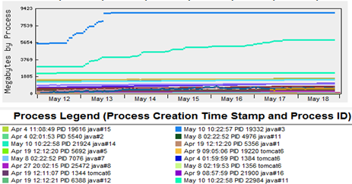
Use a more consistent graphical language: Ramps that will fill soon are bad
The next step is to show them is memory by process, and raise your hand if you have never seen java increase memory usage:

Slide 56
Use a more consistent graphical language: Ramps that will fill soon are bad
The next step is to show them is memory by process, and raise your hand if you have never seen java increase memory usage:

Slide 57
Use a more consistent graphical language: Ramps that will fill soon are bad
There are a lot more types of ramps to think about.
I, for one, am convinced that the delete button on most keyboards of applications stopped working many years ago
The constant increase in disk utilization is well documented
You can even make it easier on them. Here we see a disk space history and forecast (dotted trend line) chart that we have for every disk at my firm

Slide 58
Use a more consistent graphical language: Ramps that will fill soon are bad
In this case, we forecast a full drive in 20 days
In addition to the graphs, we send out mail (with clickable links to the graphs or course) for all drives likely to fill in the next 60 days.
Automated forecasting estimates with Low Confidence /appl/perform/manager on ustcl004 will be full in 20 days. Please take action to add space or remove data prior to then to avoid an outage.
This simple technique has virtually eliminated disk full outages at our global firm
Shouldn’t everyone be doing this, and maybe not just for disk space?

Slide 59
Logic problem
Full memory is not bad, but that is not what casual capacity planning report users will think
On windows machines we tried graphing the sum of installed memory and the page file size (we call that sum the CommitLimit) and the bytes in use, (we called that CommitBytes)
but to be honest, it never really caught on with the casual users, even though it is a great predictor/explainer of when hard windows paging occurs
When there is a memory graph around, that is all that they will ever see

Slide 60
Logic problem
On *nix machines, we don’t have CommitLimit or CommitBytes) so we use what we have

Slide 61
Logic problem
Here you can see that while we do show total memory,
we also try to highlight times when the system might feel memory stress by showing times when page scans are occurring
The problem with that is, folks will immediately focus on spikes and yell,
but as anyone who has shown folks this can attest
it is extremely common to have spikes when you are running backups
By simply stacking the graphs, this is quickly evident, letting folks concentrate their analysis on non-backup times, or when they see the swap file space used rise

Slide 62
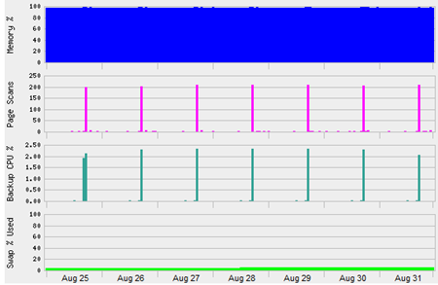
Logic problem

Slide 63
Logic problem
Compare that system that is not undergoing any memory stress to a machine that is doing a lot of work,
trying very hard to cache data,
and probably keeping a bit too much of it on disk, considering the number of hours and intensity of its backups processing
We’ll start, of course, with workload characterized CPU consumption on this nightly batch workload:

Slide 64
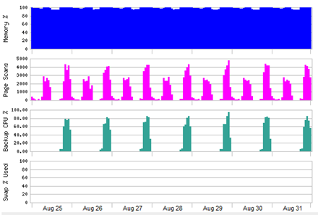
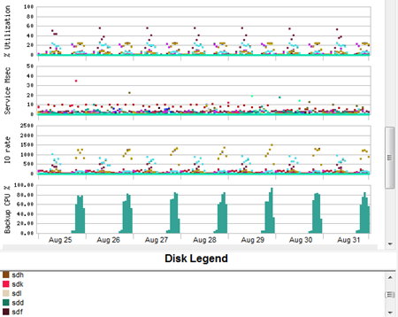
Is there a memory problem on this Unix machine?
Memory sure looks full
Since we see almost no swap file usage, this machine technically has enough memory, but if you are like me, you might worry about overloading its disk drives
Here we can see not only plenty of IOs, but also which drives have heavier backup loads and which drives do more daily web page building processing
Note also how the disk drives are tuned to not let any drive exceed 60% utilization

Slide 65
Is there a memory problem on this Unix machine?
I can hear the queuing theory tool users at this point yelling
“Ron! Mere usage does not matter; response times growing is all that matters!”
and they are correct!
The following graph is for those picky folks:
Adroit viewers will see that there are no waits during critical nightly processing and some higher IO Service and just a bit of IO Wait only during backups
Even more adroit viewers will notice the clue that non backup high Page Scans happen not during the high nightly batch processing, but instead during the minimal CPU usage web page building part of the daily work
Making tons of unrelated graphics is about as diverse and un-cache-able as you can get, so those Page Scans make sense and are unavoidable

Slide 66
Lots of good graphics dispel incorrect assumptions
Note that we just discussed the performance of a heavily loaded and complex nightly batch system using the tools of graphics, color coded text, and graph stacking in a way that even a non-geek project manager could understand!
Nothing dispels mistaken impressions and needless hardware usage fears faster than these tools
If your goal is to speed your organization to work on real issues and stop wasting time on spurious issues, great graphics are a great place to start

Slide 67
Lots of good graphics dispel incorrect assumptions
Great workload characterized network queuing theory based products let you do
application and hardware tuning that gets rid of waits, and
lets you load up right to the edge of, but not past, where performance problems would otherwise start to appear

Slide 68
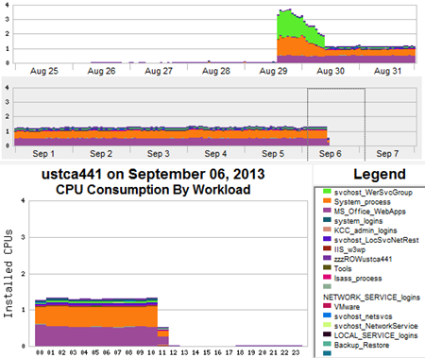
A Workload that all windows machines should have
When someone tries to run and application and it crashes, it causes windows to create WerFault processes and svchost_WerSvcGroup processes
On a Thursday, something on this machine crashed a whole lot and it continued, albeit at a slower rate
I was betting that the large System process CPU is related too
Can you tell when they finally configured the new application properly?
Go looking for WerFault processes and svchost_WerSvcGroup processes at your shop. I dare you. Get ready to be horrified at how many that you find

Slide 69
What to avoid
Several of my CMG pals have endured repeated calls from vendors this year,
trying to get us to consider non-workload characterized so called “VMware optimization” products,
claiming that they would save our firms thousands.
When we actually examined what they were doing, their lack of a workload characterized approach resulted in their products recommending the exact opposite of what you should do to optimize performance,
and resulted in worse performance issues than what VMware would do for itself automatically

Slide 70
What to avoid
Several of us even tried to explain to them how workloads would help,
but they continued to try to interest us in products that were bad and easily proven as a waste of time and budget dollars
They even asked me to refer them to our VMware people after I spent a half hour proving to them that their product’s logic was not only flawed, what it recommended was often harmful
So be careful, just because someone is selling it, doesn’t mean that it is worthwhile

Slide 71
Conclusions
I abandoned most commercial product outputs a while ago,
their graphics just sucked for what I wanted to do
The programming time that I had to spend was more than made up for by the increases in communication effectiveness
You should also abandon goals like “you knowing the right answer to a complex technical problem”

Slide 72
Conclusions
Instead, start experimenting with different ways to get others to understand,
rating yourself on how much you get your organization to change for the better and
how many people use your graphics to come to the right answers all by themselves
When you see folks using your web pages and graphics, and colored text to make a point,
you will lean back in your chair and smile, just like me

