Slide 1
VMware vSphere 4.0 © Capacity Management
“Now the Dust is Settling”
Charles Johnson
Metron-Athene Inc.
charles@metron-athene.com

Slide 2
Metron
IT Capacity Specialists
  Capacity Planning since 1986
Constant Innovation
  We evolve with the enterprise
Part of the IT Community
  Wrote Capacity Management for ITIL
Consulting & Support
  Trusted Advisors

Slide 3

Virtualization and Capacity Management
Avoid virtual sprawl
Maximize savings
Align business and IT
Proactive management
Keep control

Slide 4
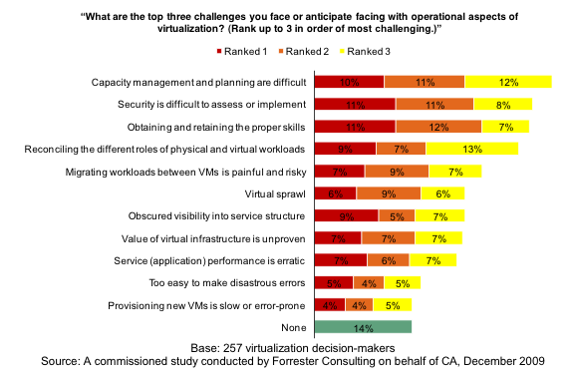
Forrester: Cloud
Capacity management is the top operational concern--it's also a mystery as the underlying capacity of virtualized servers in public clouds is largely unknown.

Slide 5
Agenda
Introduction
What is vSphere?
vSphere Enterprise Capacity Management
Notes:
Agenda
Introduction – Brief intro (next slide)
vSphere - VI4 (ESX 4.0 + vCenter 4), focuses on Enterprise, cloud computing
Enterprise Capacity with Athene – Focus on what kind of reporting is required for Clusters, Resource Pools, Hosts and Guests. Delve deeper into vSMP and CPU Overallocation/Fragmentation, take a look at Memory Management. Athene’s added extras and finally VMware’s additional functionality to assist in storage capacity issues.

Slide 6
Introduction
Capacity Management for VMware vSphere
Main focus on Cluster, Resource Pool and Host performance and capacity reporting
Cover additional VMware vSphere functionality to assist with Capacity issues
Notes:
Introduction
Now VMware vSphere has matured we take a look at Enterprise Capacity Management using Athene. The focus of this webinar is to show the kind of reporting that is required using Athene and point out and explain the definitions of some key metrics, specifically for Clusters, Resource Pools, Hosts and Guests. It also briefly covers some useful reporting functionality built-in to Athene and covers the tools provided with vSphere that help assist with Storage Capacity issues.

Slide 7
What is vSphere?
VMware VI4
ESX 4.0 / ESXi 4.0
vCenter Server (formerly Virtual Center)
Consists of several vServices
  Infrastructure, Cloud, Application
Notes:
What is vSphere?
vSphere is:
Virtual datacenter operating system, a.k.a. VI4
Consists of ESX4 + vCenter 4.0 server
Fast, flexible, resilient and efficient
The components of VI4 are still the same such as ESX and vCenter and still incorporate features such as HA/DRS and vMotion.
In vSphere, VMware have introduced what they call ‘vServices’. These vServices are essentially a logical grouping of new and existing features under service headings such as Infrastructure, Cloud and Application.
Much of the technical information on this and subsequent slides is based on information from "What’s New in VMware vSphere 4.0 training course“ details available from (http://mylearn.vmware.com/mgrreg/courses.cfm?ui=www&a=one&id_subject=10069) and “Performance Best Practices – vSphere 4.0 ©” available at http://www.vmware.com/pdf/Perf_Best_Practices_vSphere4.0.pdf

Slide 8
vSphere – Enterprise Capacity Management
CPU & Memory
  Cluster, Resource Pools, Host & Guest monitoring
  vSMP
    CPU Over Allocation (Ready Time), Workloads
  CPU Scheduling & Fragmentation
  Memory
    Ballooning, Swapping and Shared & Performance Tips
  Active vs. Consumed Memory
Disk I/O
  Latency & data traffic of storage subsystem path
Storage Capacity
  Monitoring of
    Datastore space monitoring (Physical vs. Used)
    Guest disks
    VMware applications to assist in alleviating Storage issues
User Defined Metrics
  convert standard reported output to custom
    MB to GB, MHZ to GHz
Filtering
  strip out the noise to focus on the important information
  create expressions to report on Idle, Over and Undersized guests
Notes:
Here is what we will discuss in the next few slides.

Slide 9
CPU - Clusters
Notes:
CPU – Clusters
Here is an example of an Athene CPU Cluster report. The Average CPU Usage for each ESX host member of the cluster is stacked against and plotted against the Total CPU Capacity of the cluster.
This report also shows us a good example of when some hosts were either powered down / placed in maintenance mode or not part of this cluster by Total CPU Power (red line) dipping in places on the report, but ultimately it shows us that there is plenty of headroom available across this cluster.

Slide 10
CPU – Resource Pool
CPU Limit MHz
CPU Usage MHz
Stacked Guest CPU Usage MHz
Notes:
If using resource pools, a useful report would be to plot the stacked CPU Usage of the guests on the host against the CPU Limit of the Resource Pool as this example demonstrates. The green line displayed on the report is the Host CPU Usage which matches the stacked usage of the guests running on this ESX host.
If Resource Pools are used for organizational purposes but are not limited or if you have Expandable Reservation set (Child Resource Pools only) then you will need to monitor the “root resource pool” or in other words the Host CPU Capacity.

Slide 11
CPU - Hosts
Notes:
For CPU at the Host level, it is about monitoring the CPU Usage of the Guests against the Total CPU Capacity. In this example, the Guest usage is aggregated and time summarized to a single days.
Apply Alarm or Warning thresholds to the report if required and alert accordingly.

Slide 12
CPU – Hosts (Guest Usage)
Notes:
Alternatively, create a report which breaks down the Host CPU usage by guest.

Slide 13
CPU – Hosts (Trend)
Notes:
Create forecast (trend) reports. In this example, we take the highest aggregated hour in each day for the host and Trend to 100%. You can display Trend Start and End Dates as macros on the chart so you can instantly see when the trend line hits 100%.

Slide 14
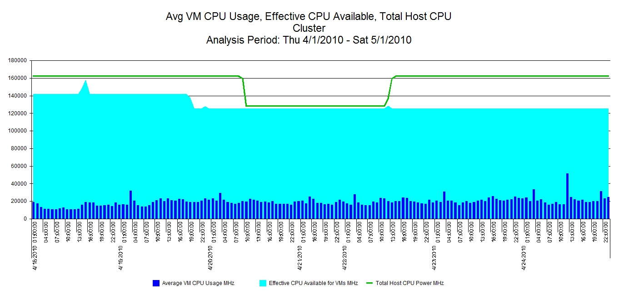
CPU Usage – All Components

Slide 15
CPU – Clusters, RPs & Hosts
Cluster
  monitor aggregated Host CPU usage against Total Host CPU Capacity of Cluster
Resource Pools
  monitor guest CPU usage against Pool limit
Hosts
  Monitor aggregated guest CPU usage against Host CPU capacity
If required - apply warning and threshold lines

Slide 16
Memory - Clusters
Effective Memory Available
Cluster Host 2
Cluster Host 1
Notes:
Lets take a look at Cluster Memory. This stacked report shows us the Effective Memory available across the Cluster and the amount of Memory being used by the cluster members.

Slide 17
Memory – Resource Pool
Pool Limit
Pool Memory Usage
Guest Memory Usage
Notes:
Another example of Resource Pool monitoring this time for Memory. Here we see a report plotting the Guest Memory Usage within the Pool against its limit. The black line displays the Pools Memory usage which matches the pattern of the stacked Guest Usage and the slight gap between them is the Memory Overhead.

Slide 18
Memory - Hosts
Notes:
A similar view to CPU, here we can show the breakdown of Host Memory Consumed by Guest against the Total Host Physical Memory. This report shows us that the amount of Total Physical Memory available was reduced by approximately 4GB, possibly a failed chip but again there is plenty of headroom available on this Host.

Slide 19
Memory - Hosts
Notes:
Another report of interest is to produce a Guest Usage chart based upon the amount of “Granted” or provisioned memory given to each guest. Remember you can over allocate memory to guests on ESX.

Slide 20
vSMP and Over allocation
What is vSMP?
  apply multiple vCPUs per Guest
  can only set vCPUs to same as ESX host cores or less
    Example : if ESX host has 4 cores then vSMP will allow up to 4vCPUs
    Maximum in vSphere is 8vCPUs.
CPU Over allocation
  ESX 4.0 supports up to 20 vCPUs per core, Max 512.
  guest – CPU Ready Time (secs)
  can lead to poor or impaired CPU performance
  check CPU shares set for guest or resource pool
    default is normal = 1000 * #vCPUs
    shares apply when there is contention for resource
  Key : monitor host, guest & CPU ready time
Workloads
  do not allocate single threaded workloads to vSMP guests
  idle “vCPUs” will use Host resources
Notes:
vSMP – This allows the VMware administrator the ability to provision guests with multiple virtual cpus (vCPUs) a.k.a Execution Threads. In vSphere you can have up to 8 vCPUs assigned to a guest.
CPU OA – ESX 4.0 supports a maximum of 20 vCPUs per physical core and 512 per host. However, unlike memory you cannot over allocate host CPU resources to guests. If CPU is over allocated it can lead to poor or impaired guest performance. This is because of the way the CPU Scheduler works and CPU Fragmentation.
Workloads – if you have assigned multiple vCPUs to a guest but this guest is running a single-threaded application and thus using only one vCPU, the remaining idle vCPU(s) will consume Host resources.

Slide 21
vSMP – Total Guest CPU %
Notes:
vSMP User Story
This ESX host (Vulture) shows us the Total CPU Utilization % reported by hosted guests over a day and summarized to hourly intervals. From this chart you can see that the largest consumers of CPU were guests CitrixVM10 and VM11. This also shows a typical working day pattern of usage between 9am and 5pm. So what, you may ask? Well lets take a deeper look at CitrixVM10 & VM11.

Slide 22
vSMP – Logical CPU Busy
Notes:
Next we take a look at the logical CPU busy % of these two guests. Straightaway, you can see that even though in our previous report CitrixVM10 used more CPU time than any other guest, CitrixVM11 is actually using more CPU seconds than VM10, actually on average 1.5 times more.
Why you may ask? Lets carry on . . . . .

Slide 23
vSMP – Guest vCPUs
Notes:
This report displays how many vCPUs are assigned to each guest on host Vulture. Specifically, we are interested in CitrixVM10 & VM11. CitrixVM10 has been assigned 4 vCPUs and VM11 2 vCPUs.

Slide 24
vSMP - CPU Ready Time
Notes:
Next by creating a CPU Ready Time (secs) report for these two guests, we can see that the amount of time spent in seconds over the day the CitrixVM10 guests spent waiting to run on physical CPUs is very large.
This explains that by having 4 vCPUs assigned is causing a detrimental effect to the CPU performance of this guest. Note that the amount of time spent by VM11 waiting for physical CPU resource. We can see that at their peak, VM10 is waiting over 6 times longer than VM11.
Again why is this you may ask? Over to CPU Scheduling.

Slide 25
CPU Scheduling
Co-Scheduling
  co-start vCPUs at the same time
  earlier ESX (2.5 & 3.0) had strict co-scheduling
Relaxed Co-Scheduling
  introduced in ESX 3.5
  subset of guests vCPUs started before others
  operating systems still require some co-scheduling
Further Relaxed Co-Scheduling
  introduced into vSphere
  mitigates CPU fragmentation by tracking each vCPU individually
  co-scheduling enforcement becomes a per-vCPU operation
http://www.vmware.com/files/pdf/perf-vsphere-cpu_scheduler.pdf
Notes:
Co-Scheduling - Co-scheduling means that the CPU scheduler has to the guests vCPUs on physical CPUs at the same time. Earlier versions of ESX also used strict co-scheduling. VMware, through each version has attempted to mitigate the effect of CPU fragmentation cause by CPU scheduling and in VI3 introduced Relaxed Co-scheduling.
Lets use an example of you and a friend on a bike ride.
The strict co-scheduling may cause CPU-fragmentation. For example, a 2-vCPU multi-processor virtual machine may not be scheduled if there is only one idle pCPU. This results in a scheduling delay and lower CPU utilization – in terms of your ride, imagine one of the bikes has a puncture therefore not being able to both go on a ride at the same time because only one bike is working and you need to go together.
RCS - Later when VMware released ESX version 3.5, an improved form of co-scheduling was introduced called Relaxed Co-Scheduling. This worked by allowing a subset of a virtual machines vCPUs to be scheduled ahead of others, but as guest operating systems still require some degree of co-scheduling it meant that the relaxation isn't absolute.
In other words imagine your friend starts to slow up and fall behind on your ride to such a distance that you both stop. The Virtual Machine will be scheduled again (co-start) when there are enough pCPUs available to schedule all vCPUs simultaneously. This ensures the skew does not grow any further and only shrinks – or again in terms of your ride, you both start at the same time and you either slow up a bit until your friend catches up or they speed up to reduce the distance between you.
Further RCS - In VI4, we now have Further Relaxed Co-scheduling. Building on the advances of Relaxed Co-Scheduling, Further Relaxed Co-Scheduling mitigates CPU fragmentation by tracking each vCPU individually. This is now a per vCPU operation and allows vCPUs to start and stop independently but the guest is co-stopped if a threshold measuring the skew between vCPUs is broken.
In ESX 4, instead of stopping or starting a set of vCPUs, only the vCPUs that advanced too much are individually stopped. Once the lagging vCPUs catch up, the stopped vCPUs may start individually or in other words if you get too far ahead of your friend on your ride, you have to stop to wait for your friend to catch up whereas previously you both had to stop.

Slide 26
CPU Fragmentation
Processing delay caused by strict co-scheduling
  CPU ready time
Hyperthreaded Servers – less likely to encounter fragmentation
  hypervisor presented with double the number of hardware threads
Notes:
Most operating systems still require some degree of strict co-scheduling and therefore if you provision guests with higher number of vCPUs, they will have to compete for physical CPUs with other guests assigned with lower numbers of vCPUs. This can lead to CPU fragmentation.
In this case, it is key as shown in the earlier example to monitor CPU Ready Time.
Using hyperthreading can limit the impact of CPU fragmentation by presenting double the number of what the hypervisor thinks are physical CPUs to schedule the vCPUs on. As we know hyperthreading is not the same as doubling the number of physical CPUs in terms of throughput.

Slide 27
Memory - Management
Notes:
As previously mentioned, you can over allocate memory for guests on ESX. This works on the basis that not all memory allocated will be used by all the guests at the same time. To alleviate any potential memory issues overallocation could present, ESX has some memory management techniques such as Ballooning, Sharing and ultimately Swapping to keep things running smoothly.

Slide 28
Memory - Management
Ballooning
  early indication of memory pressure on ESX host
  driver installed in Windows Guests via VMware Tools
  reclaims unused memory by forcing Windows Guests to “page out”
Shared
  many guests of the same OS, i.e. Windows can share common memory pages
  reduces consumption with minimal impact
Swapping
  severe lack of available memory with whole processes being swapped to disk
  move guests to other hosts or allow DRS to manage
Notes:
Ballooning – A balloon driver (vmmemctl.sys) is installed into Windows guests when the recommended VMware Tools package is installed. When the ESX memory demand rises and free memory falls, typically below 10%, ESX initiates the Balloon Driver to inflate itself inside the Windows guests and force Windows to “page out” unused memory pages back to ESX. This reclaimed memory is then used to satisfy the more memory hungry guests.
Shared - Typically, you are likely to have many guests machines running similar if not the same operating systems. In this case, common memory pages can be shared between them (a.k.a. Transparent Page Sharing) and this ultimately leads to lower and more efficient use of Memory which also has minimal impact on the hypervisor itself.
This is also what provides ESX the ability to allow memory overcommitment.
Swapping - If Ballooning has been initiated and ESX still cannot meet its memory demands, then you may see some swapping. This is bad. If you have DRS enabled, you may see a rise in the number of vMotions (migrations) to other hosts in the cluster as it attempts to load balance.

Slide 29
Memory – Active vs. Consumed
Active
  amount of physical host memory currently used by the guest
  displayed as “Guest Memory Usage” in vCenter at Guest level
Consumed
  amount of physical ESX memory allocated (granted) to the guest, accounting for savings from memory sharing with other guests.
  includes memory used by Service Console & VMKernel
  displayed as “Memory Usage” in vCenter at Host level
  displayed as “Host Memory Usage” in vCenter at Guest level
Notes:
In case of any confusion, here is what Active and Consumed Memory means.
Active – as slide.
Consumed – As slide, plus:
Take a look at the difference between what is reported as Host Memory Usage at both the Host and Guest levels in your tool. Why? Well at the host level the Host Memory includes the usage of the VMKernel and Service Console.

Slide 30
ESX Memory - Consumed
Consumed = Granted - Shared
Notes:
Here is an example Athene chart showing the amount of Host Consumed Memory used by the guests against the amount of collective memory that has been granted to them.
Consumed memory = Granted – Shared. This can be seen clearly on the chart as the shared memory drops the amount of consumed memory increases and vice versa.

Slide 31
Memory – Performance Tips
Ensure best performance by
  host memory must be large enough to accommodate Active memory of Guests
  Guests memory size must be slightly larger than the average guests memory usage
  less than 6% of Free Memory indicates that the host cannot meet its memory requirements
Tuning
  check resource shares, reservation and limits of Guests and Hosts
  look for ballooning and swapping to indicate host memory shortages
Notes:
Memory
To ensure best performance, here are some recommendations from VMware.
The host memory must be large enough to accommodate the active memory of the virtual machines as shown in the example. The active memory can be smaller than the virtual machine memory size. This allows you to over-provision memory, but still ensures that the virtual machine active memory is smaller than the host memory.
A virtual machine's memory size must be slightly larger than the average guest memory usage. This enables the host to accommodate workload spikes without swapping memory among guests. Increasing the virtual machine memory size results in more overhead memory usage. If a virtual machine has high ballooning or swapping, check the amount of free physical memory on the host.
A free memory value of 6% or less indicates that the host cannot meet the memory requirements. This leads to memory reclamation which may degrade performance. If the active memory size is the same as the granted memory size, demand for memory is greater than the memory resources available. If the active memory is consistently low, the memory size might be too large.
Tuning
If the host has enough free memory, check the resource shares, reservations, and limit settings of the virtual machines and resource pools on the host. Verify that the host settings are adequate and not lower than those set for the virtual machines.
If the memory usage value is high, and the host has high ballooning or swapping, check the amount of free physical memory on the host. A free memory value of 6% or less indicates that the host cannot handle the demand for memory. This leads to memory reclamation which may degrade performance.

Slide 32
vSphere - Disk I/O
Notes:
DISK I/O
Use either the vSphere Client CPU performance charts or a third party performance tool to monitor Disk I/O usage.
This chart displays the recommended metrics for monitoring Disk I/O usage - Queue, Kernel and Device latency for the iSCSI Production datastore I/O path. This is not a stacked chart and shows that the highest metric reported is Device Latency (ms).

Slide 33
Disk I/O – Storage Subsystem
Monitor the disk latency counters
  kernelLatency
    measures average time VMkernel processes SCSI commands
    best performance between 0 -1 ms
    greater than 4ms, the storage system cannot support the amount of throughput from the Guests
      increase queue depth or storage
  deviceLatency
    measure average time to complete a SCSI command from the physical device
    greater than 15ms may indicate a problem with the storage array
      Move active VMDK to volume with more spindles or add disks to LUN
  queueLatency
    measures average time taken per SCSI command in the VMkernel queue.
    this value must always be Zero.
    greater than Zero indicates workload is too high and array cannot cope
Notes:
Disk I/O
The best way to determine if your vSphere environment is experiencing disk problems is to monitor the disk latency data counters. You can use either the Advanced performance charts option in vCenter or a third party capacity and performance tool to view these statistics.
The kernelLatency data counter measures the average amount of time, in milliseconds, that the VMkernel spends processing each SCSI command. For best performance, the value should be 0-1 milliseconds. If the value is greater than 4ms, the virtual machines on the ESX/ESXi host are trying to send more throughput to the storage system than the configuration supports. Check the CPU usage, and increase the queue depth or storage.
The deviceLatency data counter measures the average amount of time, in milliseconds, to complete a SCSI command from the physical device. Depending on your hardware, a number greater than 15ms indicates there are probably problems with the storage array. Move the active VMDK to a volume with more spindles or add disks to the LUN.
The queueLatency data counter measures the average amount of time taken per SCSI command in the VMkernel queue. This value must always be zero. If not, the workload is too high and the array cannot process the data fast enough.

Slide 34
Storage Capacity - Datastore Space
Notes:
This report looks at the amount of freespace available in the Production datastore against the Capacity of the datastore. Here we can see that for a period, there is a slight drop in freespace, possibly new guests being provisioned or more logical disks being added and then an increase maybe guests and /or disks being removed?

Slide 35
Storage Capacity – Guest Disks
Notes:
Here is another storage capacity example showing guest logical disk space against their capacity (dotted line as both C & D has same capacity). From this we can establish that the C drive is slowly being filled up but D remains unused.

Slide 36
Storage Capacity – VMware Functionality
Thin Provisioning
  supports storage over-commitment
  Thin disks “reserve” space but only use as and when
  monitor provisioned Storage (physical / logical) vs. Used Storage
Storage vMotion
  migrate guest disk files between datastores
VMFS Volume Grow
  extend existing extent rather than adding additional extent
  increase the capacity of a running (HOT) VMFS datastore when guests require more space
Notes:
Thin Provisioning – Allows you to create “Thin Disks” for guests that reserve space but does not lock it so that it can be used elsewhere. This allows for storage overcommitment on the premise that guests will not fulfil their reservations.
Storage vMotion – This provides the ability to migrate guest disk files between datastores if your datastore space is becoming low. Storage vMotion also allows HOT migrations, which mean your guests are kept online and are unaffected.
VMFS VG – Using VMFS volume grow you can dynamically increase your existing datastore space by extending existing extents rather than adding additional ones. This can also be performed as a HOT extend with no interruption to running guests.

Slide 37
Other functions
User Defined Metrics
  create new calculated metrics from existing metric base
  convert standard metric output to custom, i.e. MHz to GHz or MB to GB or %
  define a monetary cost to a value, i.e. 1% = $1 for Guest usage of ESX host
Filtering
  create and apply dynamic expression filters to charts
  remove the noise to display only what you need to see
    i.e. Guest CPU Busy > 70%
  use for Idle, Over and Undersized guest reporting
Notes:
UD Metrics – Athene provides the ability to create user defined metrics. User defined metrics allow the user to define their own expressions using either the standard metrics supplied or using user defined metrics.
You can create these metrics to change standard output to custom output, e.g. MB to GB or MHz to GHz etc or convert to percentages where they are not originally available and be able to define a monetary cost to a percent or MB/MHz etc.
Filtering – Another feature provided is Filtering. This allows you to define queries containing expression filters (either dynamic / static) to apply to your charts to remove any excess noise and display exactly want to want or need to see, i.e. Guest CPU > 70%.

Slide 38
Filtering – pre filter
Notes:
Here we have a pre-filtered report of Guest Memory used on host Falcon. Note the number of guests being displayed.

Slide 39
Filtering – filter over 1GB – remove noise
Notes:
Now we create and apply a dynamic expression filter to the chart of Memory Used in MB > 1000. Only the guests that used more than this value are displayed within the chosen analysis period.

Slide 40
Filtering - Oversized, Undersized and Idle Guests Reporting
Create expressions (and’d) for:
  Idle :
    Ave. Guest CPU Usage < 10%
    Ave. aggregate storage performance statistics < 2.5 KB/sec
    Ave. aggregated network performance statistics < 0.125 KB/sec
  Oversized
    Average Guest CPU Usage < 30 %
    Memory Guest Usage < 30%
  Undersized
    Average Guest CPU > 70%
    Memory Guest Usage > 70%
Notes:
The stated expressions have been provided by VMware. By creating these expressions for each condition, you will be able to report on whether as guest is, during either one or many intervals classed as:
Idle
Oversized
Undersized
This would then provide the necessary information to allow for Idle and Oversized systems to be either reconfigured or host additional or increased workload and for Undersized systems to be upgraded to handle the current workload or consolidate onto other guests.

Slide 41
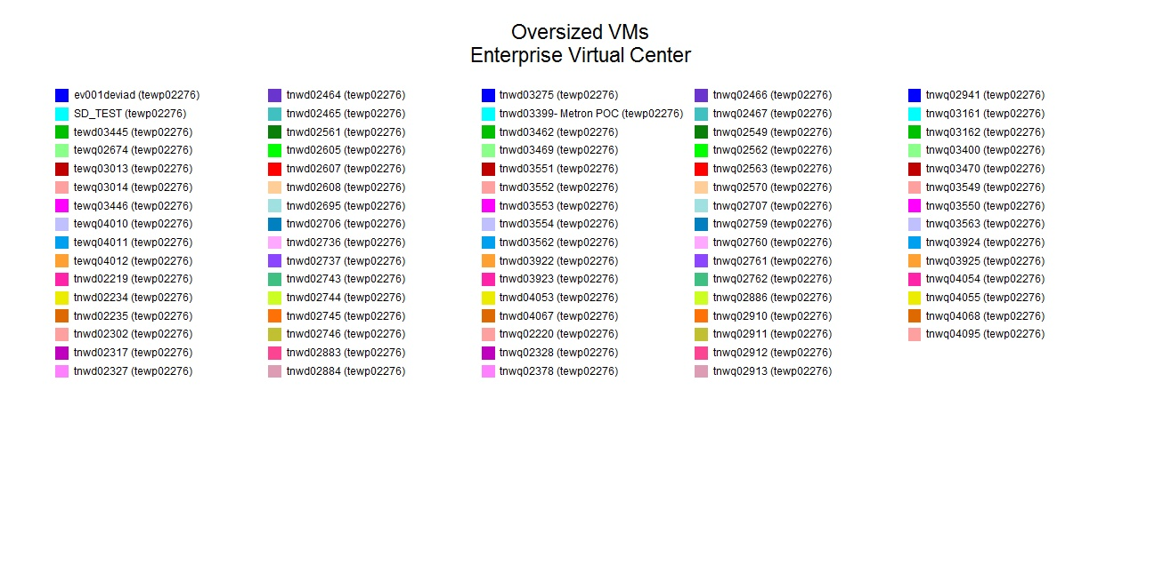
Oversized VMs

Slide 42
RECAP – Enterprise Capacity Management
CPU & Memory
  Cluster, Resource Pools, Host & Guest monitoring
  vSMP
    CPU Over Allocation (Ready Time), Workloads
  CPU Scheduling & Fragmentation
  Memory
    Ballooning, Swapping and Shared & Performance Tips
  Active vs. Consumed Memory
Disk I/O
  Latency & data traffic of storage subsystem path
Storage Capacity
  Monitoring of
    Datastore space monitoring (Physical vs. Used)
    Guest disks
    VMware applications to assist in alleviating Storage issues
User Defined Metrics
  convert standard reported output to custom
    MB to GB, MHZ to GHz
Filtering
  strip out the noise to focus on the important information
  create expressions to report on Idle, Over and Undersized guests

Slide 43
VMware vSphere 4.0 © Capacity Management
“Now the Dust is Settling”
Charles Johnson
Metron-Athene Inc.
charles@metron-athene.com

